Slide 1

Unit – 8 Code Generation
Compiler Design (CD)
GTU # 2170701
Prof. Dixita B. Kagathara
Computer Engineering Department
dixita.kagathara@darshan.ac.in
+91 - 97277 47317 (CE Department)

Slide 2
Topics to be covered
Issues in code generation
Target machine
Basic block and flow graph
Transformation on basic block
Next use information
Register allocation and assignment
DAG representation of basic block
Generation of code from DAG

Looping

Slide 3
Issues in Code Generation

Slide 4
Issues in Code Generation
Issues in Code Generation are:
Input to code generator
Target program
Memory management
Instruction selection
Register allocation
Choice of evaluation
Approaches to code generation

Slide 5
Input to code generator
Input to the code generator consists of the intermediate representation of the source program.
Types of intermediate language are:
Postfix notation
Quadruples
Syntax trees or DAGs
The detection of semantic error should be done before submitting the input to the code generator.
The code generation phase requires complete error free intermediate code as an input.

Slide 6
Target program
The output may be in form of:
Absolute machine language: Absolute machine language program can be placed in a memory location and immediately execute.
Relocatable machine language: The subroutine can be compiled separately. A set of relocatable object modules can be linked together and loaded for execution.
Assembly language: Producing an assembly language program as output makes the process of code generation easier, then assembler is require to convert code in binary form.

Slide 7
Memory management
Mapping names in the source program to addresses of data objects in run time memory is done cooperatively by the front end and the code generator.
We assume that a name in a three-address statement refers to a symbol table entry for the name.
From the symbol table information, a relative address can be determined for the name in a data area.

Slide 8
Instruction selection
Example: the sequence of statements
a := b + c
d := a + e
would be translated into
MOV b, R0
ADD c, R0
MOV R0, a
MOV a, R0
ADD e, R0
MOV R0, d
Here the fourth statement is redundant, so we can eliminate that statement.

Slide 9
Register allocation
The use of registers is often subdivided into two sub problems:
During register allocation, we select the set of variables that will reside in registers at a point in the program.
During a subsequent register assignment phase, we pick the specific register that a variable will reside in.
Finding an optimal assignment of registers to variables is difficult, even with single register value.
Mathematically the problem is NP-complete.

Slide 10
Choice of evaluation
The order in which computations are performed can affect the efficiency of the target code.
Some computation orders require fewer registers to hold intermediate results than others.
Picking a best order is another difficult, NP-complete problem.

Slide 11
Approaches to code generation
The most important criterion for a code generator is that it produces correct code.
The design of code generator should be in such a way so it can be implemented, tested, and maintained easily.

Slide 12
Target Machine

Slide 13
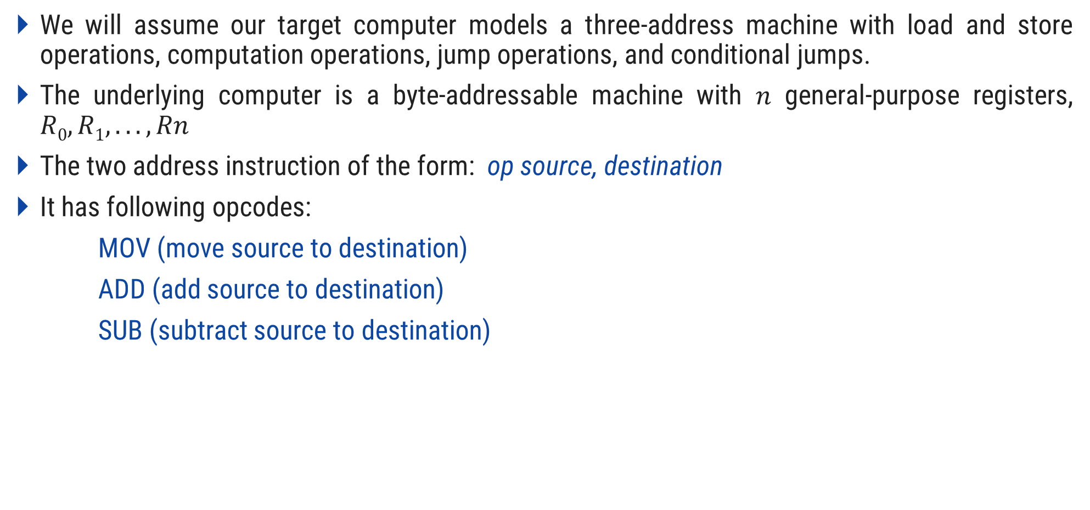
Target machine
We will assume our target computer models a three-address machine with load and store operations, computation operations, jump operations, and conditional jumps.
The underlying computer is a byte-addressable machine with $n$ general-purpose registers, $R0, R1, . . . , Rn$
The two address instruction of the form: op source, destination
It has following opcodes:
MOV (move source to destination)
ADD (add source to destination)
SUB (subtract source to destination)

Slide 14
Instruction Cost
The address modes together with the assembly language forms and associated cost as follows:
The instruction cost can be computed as one plus cost associated with the source and destination addressing modes given by “extra cost”.
Mode | Form | Address | Extra cost
Absolute | M | M | 1
Register | R | R | 0
Indexed | k(R) | k +contents(R) | 1
Indirect register | *R | contents(R) | 0
Indirect indexed | *k(R) | contents(k + contents(R)) | 1

Slide 15
Instruction Cost
Calculate cost for following:
Mode | Form | Address | Extra cost
Absolute | M | M | 1
Register | R | R | 0
Indexed | k(R) | k +contents(R) | 1
Indirect register | *R | contents(R) | 0
Indirect indexed | *k(R) | contents(k + contents(R)) | 1
MOV B,R0 ADD C,R0 MOV R0,A | MOV B,R0→ cost = 1+1+0=2 ADD C,R0→ cost = 1+1+0=2 MOV R0,A→ cost = 1+0+1=2
 | Total Cost=6

Slide 16
Instruction Cost
Calculate cost for following:
Mode | Form | Address | Extra cost
Absolute | M | M | 1
Register | R | R | 0
Indexed | k(R) | k +contents(R) | 1
Indirect register | *R | contents(R) | 0
Indirect indexed | *k(R) | contents(k + contents(R)) | 1
MOV *R1 ,*R0 MOV *R1 ,*R0 | MOV *R1 ,*R0 → cost = 1+0+0=1 MOV *R1 ,*R0 → cost = 1+0+0=1
 | Total Cost=2

Slide 17
Basic Block & Flow Graph

Slide 18
Basic Blocks
A basic block is a sequence of consecutive statements in which flow of control enters at the beginning and leaves at the end without halt or possibility of branching except at the end.
The following sequence of three-address statements forms a basic block:
t1 := a*a
t2 := a*b
t3 := 2*t2
t4 := t1+t3
t5 := b*b
t6 := t4+t5

Slide 19
Algorithm: Partition into basic blocks
Input: A sequence of three-address statements.
Output: A list of basic blocks with each three-address statement in exactly one block.
Method:
We first determine the set of leaders, for that we use the following rules:
The first statement is a leader.
Any statement that is the target of a conditional or unconditional goto is a leader.
Any statement that immediately follows a goto or conditional goto statement is a leader.
2. For each leader, its basic block consists of the leader and all statements up to but not including the next leader or the end of the program.

Slide 20
Example: Partition into basic blocks
begin
prod := 0;
i := 1;
do
prod := prod + a[t1] * b[t2];
i := i+1;
while i<= 20
end
Block B1
(1) prod := 0
(2) i := 1
(3) t1 := 4*i
(4) t2 := a [t1]
(5) t3 := 4*i
(6) t4 :=b [t3]
(7) t5 := t2*t4
(8) t6 := prod +t5
(9) prod := t6
(10) t7 := i+1
(11) i := t7
(12) if i<=20 goto (3)
Leader
Leader
Block B2
Three Address Code

Slide 21
Flow Graph
We can add flow-of-control information to the set of basic blocks making up a program by constructing a direct graph called a flow graph.
Nodes in the flow graph represent computations, and the edges represent the flow of control.
Example of flow graph for following three address code:
prod=0
i=1
Block B1
t1 := 4*i
t2 := a [t1]
t3 := 4*i
t4 :=b [t3]
t5 := t2*t4
t6 := prod +t5
prod := t6
t7 := i+1
i := t7
if i<=20 goto B2
Flow Graph
Block B2

Slide 22
Transformation on Basic Blocks

Slide 23
Transformation on Basic Blocks
A number of transformations can be applied to a basic block without changing the set of expressions computed by the block.
Many of these transformations are useful for improving the quality of the code.
Types of transformations are:
Structure preserving transformation
Algebraic transformation

Slide 24
Structure Preserving Transformations
Structure-preserving transformations on basic blocks are:
Common sub-expression elimination
Dead-code elimination
Renaming of temporary variables
Interchange of two independent adjacent statements

Slide 25
Common sub-expression elimination
Consider the basic block,
a:= b+c
b:= a-d
c:= b+c
d:= a-d
The second and fourth statements compute the same expression, hence this basic block may be transformed into the equivalent block:
a:= b+c
b:= a-d
c:= b+c
d:= b

Slide 26

Dead-code elimination
Suppose $x i$s dead, that is, never subsequently used, at the point where the statement $x:=y+z$ appears in a basic block.
Above statement may be safely removed without changing the value of the basic block.

Slide 27
Renaming of temporary variables
Suppose we have a statement
t:=b+c, where t is a temporary variable.
If we change this statement to
u:= b+c, where u is a new temporary variable,
Change all uses of this instance of t to u, then the value of the basic block is not changed.
In fact, we can always transform a basic block into an equivalent block in which each statement that defines a temporary defines a new temporary.
We call such a basic block a normal-form block.

Slide 28

Interchange of two independent adjacent statements
Suppose we have a block with the two adjacent statements,
t1:= b+c
t2:= x+y
Then we can interchange the two statements without affecting the value of the block if and only if neither $x$ nor $y$ is $t1$ and neither $b$nor $c$ is $t2$.
A normal-form basic block permits all statement interchanges that are possible.

Slide 29
Algebraic Transformation
Countless algebraic transformation can be used to change the set of expressions computed by the basic block into an algebraically equivalent set.
The useful ones are those that simplify expressions or replace expensive operations by cheaper one.
Example: x=x+0 or x=x*1 can be eliminated.

Slide 30
Next Use Information

Slide 31
Computing Next Uses
The next-use information is a collection of all the names that are useful for next subsequent statement in a block.
The use of a name is defined as follows,
Consider a statement,
x := i
j := x op y
That means the statement j uses value of x.
The next-use information can be collected by making the backward scan of the programming code in that specific block.

Slide 32
Storage for Temporary Names
For the distinct names each time a temporary is needed. And each time a space gets allocated for each temporary.
To have optimization in the process of code generation we pack two temporaries into the same location if they are not live simultaneously.
Consider three address code as,
t1=a*a
t2=a*b
t3=4*t2
t4=t1+t3
t5=b*b
t6=t4+t5
t1=a*a
t2=a*b
t2=4*t2
t1=t1+t2
t2=b*b
t1=t1+t2

Slide 33
Register and Address Descriptors
The code generator algorithm uses descriptors to keep track of register contents and addresses for names.
Address descriptor stores the location where the current value of the name can be found at run time. The information about locations can be stored in the symbol table and is used to access the variables.
Register descriptor is used to keep track of what is currently in each register. The register descriptor shows that initially all the registers are empty. As the generation for the block progresses the registers will hold the values of computation.

Slide 34
Register Allocation & Assignment

Slide 35
Register Allocation & Assignment
Efficient utilization of registers is important in generating good code.
There are four strategies for deciding what values in a program should reside in a registers and which register each value should reside.
Strategies are:
Global Register Allocation
Usage Count
Register assignment for outer loop
Register allocation for graph coloring

Slide 36
Global Register Allocation
Global register allocation strategies are:
The global register allocation has a strategy of storing the most frequently used variables in fixed registers throughout the loop.
Another strategy is to assign some fixed number of global registers to hold the most active values in each inner loop.
The registers are not already allocated may be used to hold values local to one block.
In certain languages like C or Bliss programmer can do the register allocation by using register declaration to keep certain values in register for the duration of the procedure.
Example:
{
register int x;
}

Slide 37
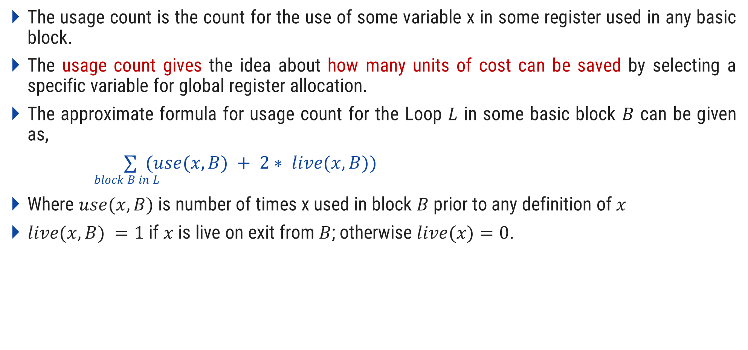
Usage count
The usage count is the count for the use of some variable x in some register used in any basic block.
The usage count gives the idea about how many units of cost can be saved by selecting a specific variable for global register allocation.
The approximate formula for usage count for the Loop $L$ in some basic block $B$ can be given as,
$∑ (use(x,B) + 2∗ live(x,B))$
$$block B in L$$
Where $use(x,B)$ is number of times x used in block $B$ prior to any definition of $x$
$live(x,B) =1$if $x$ is live on exit from $B$; otherwise $live(x)=0$.

Slide 38
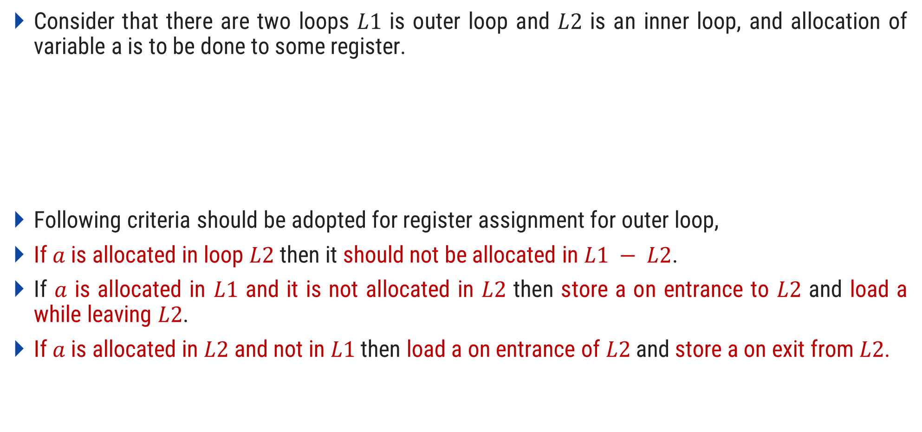
Register assignment for outer loop
Consider that there are two loops $L1$ is outer loop and $L2$ is an inner loop, and allocation of variable a is to be done to some register.
Following criteria should be adopted for register assignment for outer loop,
If $a$ is allocated in loop $L2$ then it should not be allocated in $L1 − L2$.
If $a$ is allocated in $L1$ and it is not allocated in $L2$ then store a on entrance to $L2$ and load a while leaving $L2$.
If $a$ is allocated in $L2$ and not in $L1$ then load a on entrance of $L2$ and store a on exit from $L2$.
Loop L₁
Loop L₂
L₁-L₂

Slide 39
Register allocation for graph coloring
The graph coloring works in two passes. The working is as given below:
In the first pass the specific machine instruction is selected for register allocation. For each variable a symbolic register is allocated.
In the second pass the register inference graph is prepared.
In register inference graph each node is a symbolic registers and an edge connects two nodes where one is live at a point where other is defined.
Then a graph coloring technique is applied for this register inference graph using k-color.
The k-colors can be assumed to be number of assignable registers.
In graph coloring technique no two adjacent nodes can have same color. Hence in register inference graph using such graph coloring principle each node is assigned the symbolic registers so that no two symbolic registers can interfere with each other with assigned physical registers.

Slide 40
DAG Representation of Basic Block

Slide 41
Algorithm: DAG Construction
We assume the three address statement could of following types:
Case (i) x:=y op z
Case (ii) x:=op y
Case (iii) x:=y
With the help of following steps the DAG can be constructed.
Step 1: If y is undefined then create node(y). Similarly if z is undefined create a node (z)
Step 2:
Case(i) create a node(op) whose left child is node(y) and node(z) will be the right child. Also check for any common sub expressions.
Case (ii) determine whether is a node labeled op, such node will have a child node(y).
Case (iii) node n win be node(y).
Step 3: Delete x from list of identifiers for node(x). Append x to the list of attached identifiers for node n found in 2.

Slide 42







DAG Representation of Basic Block
Example:
(1) t1 := 4*i
(2) t2 := a [t1]
(3) t3 := 4*i
(4) t4 :=b [t3]
(5) t5 := t2*t4
(6) t6 := prod +t5
(7) prod := t6
(8) t7 := i+1
(9) i := t7
(10) if i<=20 goto (1)
, prod
t₆
$$+$$
prod
$$∗$$
t₅
t₄
$$≤$$
(1)
$$[ ]$$
t₂
$$[ ]$$
,t₃
t₁
$$∗$$
$$+$$
t₇
20
, i
a
b
4
i
1

Slide 43
Applications of DAG
The DAGs are used in following:
Determining the common sub-expressions.
Determining which names are used inside the block and computed outside the block.
Determining which statements of the block could have their computed value outside the block.
Simplifying the list of quadruples by eliminating the common sub-expressions and not performing the assignment of the form x:=y unless and until it is a must.

Slide 44
Generation of Code from DAGs

Slide 45
Generation of Code from DAGs
Methods generating code from DAGs are:
Rearranging Order
Heuristic ordering
Labeling algorithm

Slide 46




Rearranging Order
The order of three address code affects the cost of the object code being generated.
By changing the order in which computations are done we can obtain the object code with minimum cost.
Example:
t1:=a+b
t2:=c+d
t3:=e-t2
t4:=t1-t3
Three Address Code
$$−$$
t4
$$−$$
t3
t1
$$+$$
e
$$+$$
t2
a
b
c
d

Slide 47
Example: Rearranging Order
t1:=a+b
t2:=c+d
t3:=e-t2
t4:=t1-t3
Three Address Code
t2:=c+d
t3:=e-t2
t1:=a+b
t4:=t1-t3
Three Address Code
Re-arrange
MOV a, R0
ADD b, R0
MOV c, R1
ADD d, R1
MOV R0, t1
MOV e, R0
SUB R1, R0
MOV t1, R1
SUB R0, R1
MOV R1, t4
Assembly Code
MOV c, R0
ADD d, R0
MOV e, R1
SUB R0, R1
MOV a, R0
ADD b, R0
SUB R1, R0
MOV R0, t4
Assembly Code

Slide 48
Algorithm: Heuristic Ordering
Obtain all the interior nodes. Consider these interior nodes as unlisted nodes.
while(unlisted interior nodes remain)
{
pick up an unlisted node n, whose parents have been listed
list n;
while(the leftmost child m of n has no unlisted parent AND is not leaf)
{
List m;
n=m;
}
}

Slide 49


























Example: Heuristic Ordering
$$∗$$
$$1$$
$$Interior nodes=1 2 3 4 5 6 8$$
$$Unlisted nodes=1 2 3 4 5 6 8$$
$$2$$
$$+$$
$$−$$
$$3$$
$$∗$$
Pick up an unlisted node,
whose parents have been listed
$$4$$
$$1$$
$$−$$
$$5$$
$$8$$
$$+$$
Leftchild of 2 =
Parent 5 is not listed so can’t list 6
Leftchild of 1 =
Parent 1 is listed so list 2
$$6$$
$$2$$
$$6$$
$$+$$
$$7$$
$$c$$
$$d$$
$$e$$
11
12
$$9$$
$$a$$
$$b$$
10
Listed Node | 1 | 2

Slide 50

























Example: Heuristic Ordering
$$∗$$
$$1$$
$$Interior nodes=1 2 3 4 5 6 8$$
$$Unlisted nodes=1 2 3 4 5 6 8$$
$$2$$
$$+$$
$$−$$
$$3$$
$$∗$$
Pick up an unlisted node,
whose parents have been listed
$$4$$
$$−$$
$$5$$
$$8$$
$$+$$
Leftchild of 3 =
Parent 2,3 are listed so list 4
Rightchild of 1 =
Parent 1 is listed so list 3
$$3$$
$$4$$
$$6$$
$$+$$
$$7$$
$$c$$
$$d$$
$$e$$
11
12
$$9$$
$$a$$
$$b$$
10
Listed Node | 1 | 2 | 3 | 4

Slide 51







Example: Heuristic Ordering
$$∗$$
$$1$$
$$Interior nodes=1 2 3 4 5 6 8$$
$$Unlisted nodes=1 2 3 4 5 6 8$$
$$2$$
$$+$$
$$−$$
$$3$$
$$∗$$
Pick up an unlisted node,
whose parents have been listed
$$4$$
$$−$$
$$5$$
$$8$$
$$+$$
Leftchild of 5 =
Parent 2,5 are listed so list 6
Leftchild of 4 =
Parent 4 is listed so list 5
$$6$$
$$5$$
$$6$$
$$+$$
$$7$$
$$c$$
$$d$$
$$e$$
11
12
$$9$$
$$a$$
$$b$$
10
Listed Node | 1 | 2 | 3 | 4 | 5 | 6

Slide 52

Example: Heuristic Ordering
$$∗$$
$$1$$
$$Interior nodes=1 2 3 4 5 6 8$$
$$Unlisted nodes=1 2 3 4 5 6 8$$
$$2$$
$$+$$
$$−$$
$$3$$
$$∗$$
Pick up an unlisted node,
whose parents have been listed
$$4$$
$$−$$
$$5$$
$$8$$
$$+$$
Rightchild of 4 =
Parent 4 is listed so list 8
$$8$$
$$6$$
$$+$$
$$7$$
$$c$$
$$d$$
$$e$$
11
12
$$9$$
$$a$$
$$b$$
10
Listed Node | 1 | 2 | 3 | 4 | 5 | 6 | 8

Slide 53
Example: Heuristic Ordering
$$∗$$
$$1$$
Listed Node | 1 | 2 | 3 | 4 | 5 | 6 | 8
$$2$$
$$+$$
$$−$$
$$3$$
Reverse Order for three address code = 8 6 5 4 3 2 1
$$∗$$
$$4$$
t8=d+e
t6=a+b
t5=t6-c
t4=t5*t8
t3=t4-e
t2=t6+t4
t1=t2*t3
OptimalThree
Address
code
$$−$$
$$5$$
$$8$$
$$+$$
$$6$$
$$+$$
$$7$$
$$c$$
$$d$$
$$e$$
11
12
$$9$$
$$a$$
$$b$$
10

Slide 54
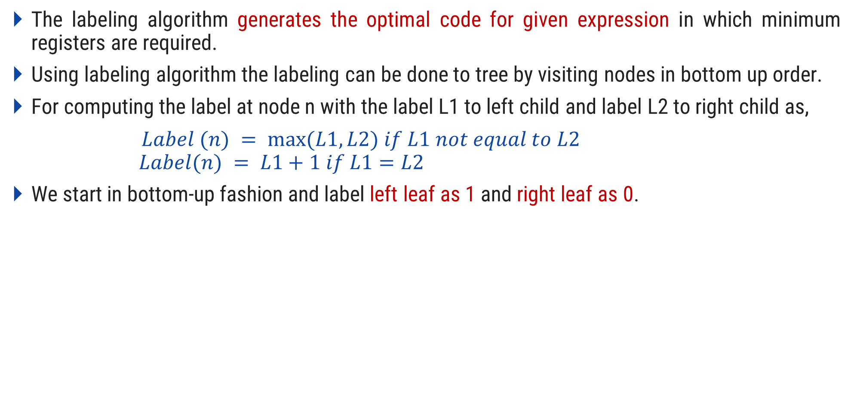
Labeling Algorithm
The labeling algorithm generates the optimal code for given expression in which minimum registers are required.
Using labeling algorithm the labeling can be done to tree by visiting nodes in bottom up order.
For computing the label at node n with the label L1 to left child and label L2 to right child as,
$Label (n) = max⁡(L1,L2) if L1 not equal to L2$
$$Label(n) = L1+1 if L1=L2$$
We start in bottom-up fashion and label left leaf as 1 and right leaf as 0.

Slide 55



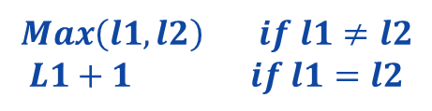




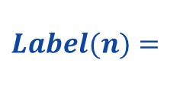







Example: Labeling Algorithm
t1:=a+b
t2:=c+d
t3:=e-t2
t4:=t1-t3
Three Address Code
$$Label(n)=$$
$$Max\left(l1,l2\right) if l1≠l2$$
$$L1+1 if l1=l2$$
$$2$$
$$−$$
t4
$$2$$
t1
$$−$$
t3
$$1$$
$$+$$
$$1$$
$$1$$
e
$$+$$
t2
$$1$$
a
b
$$0$$
$$1$$
c
d
$$0$$
$$postorder traversal=a b t1 e c d t2 t3 t4$$

Slide 56
Thank You

